Slide 1


Titolo presentazione sottotitolo
ACA – Project P17
Milano, XX mese 20XX
Authors: Roberto Bigazzi 899411 – Filippo Collini 905628
Professor: Cristina Silvano – Project Instructor: Ahmet Erdem

Slide 2
Project Description
Name: Tensorflow Neural Network Complexity Scaling
Code: P17
Type: Programming(Python)
Description:
Tensorflow being a high-level python framework mainly for Neural Network applications
may behave quite differently based on the complexity of application requirements. The
main concern is upon reaching some certain thresholds, it may not perform well or its
performance scaling may not be as desirable as before. Therefore, the objective of this
project is the explore and discover the ranges of parameters related to computation
complexity and make an analysis on the scaling of the execution time of the inference
phase (not the training phase).
The generation of benchmarks must be automated as much as possible and it must be
configurable with a config-file. The suggested degrees of freedoms are ”number of layers”, ”size of convolutions”, ”size of input”, ”batching of input”, etc. The expected deliverables of the project are:
Configuration files for benchmark generation.
Python scripts that run the Tensorflow benchmarks.
Analysis results with graphs to justify the claims.

Slide 3
Tested Hardaware
We used 2 machines to run more differentiated tests:
OS: Ubuntu Linux 19.04
Processor: Intel Core i7-4710HQ
GPU: NVIDIA GeForce GTX 860M 2048 MB
RAM: 16 GB
And
OS: macOS Mojave 10.14.6
Processor: Intel Core i5-5257U
GPU: Intel Iris Graphics 6100 1536 MB
RAM: 8 GB

Slide 4
Models built
Fashion MNIST Classifier
Model that will learn to classify fashion clothes from Zalando database.
Text Classifier
Model that will predict if a review of a movie is a good or a bad review.

Slide 5
Degrees of freedom
Size of input
28x28x1 grayscale images (Fashion MNIST)
56 characters consisting in a truncated review
Number of layers
4, 6, 8, 10
Size of batching
1, 4, 16, 64
Size of convolutions
3, 5, 8

Slide 6
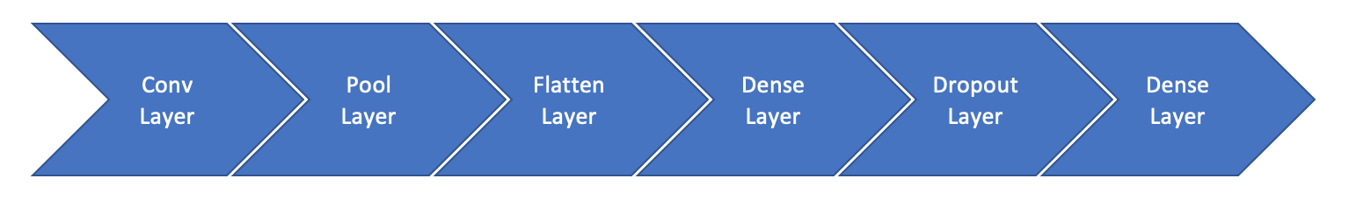
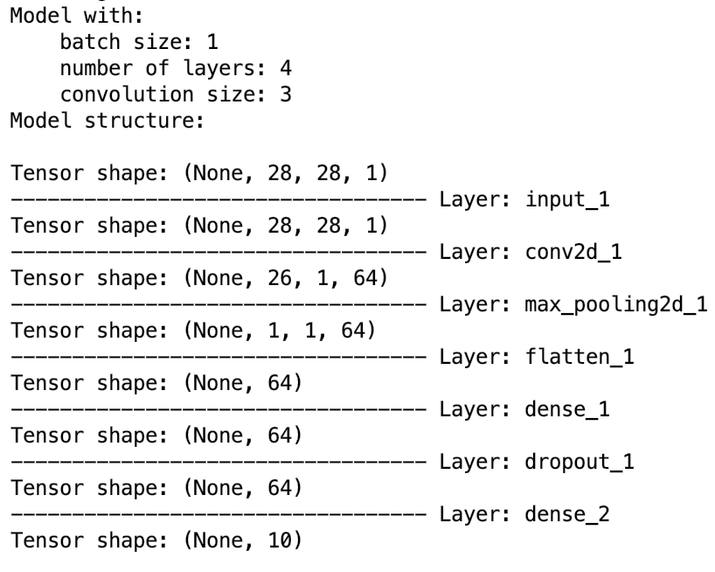
MNIST Model
Input: 28x28x1 grayscale images
Model made of:
Convolutional Layer
Pooling Layer
2 Fully Connected Layers
With 6, 8, 10 total layers we’ll add every time a Convolutional and a Pooling layer.
Always present the Flatten, Dense and Dropout layers.

Slide 7
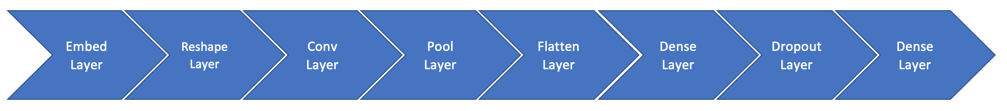
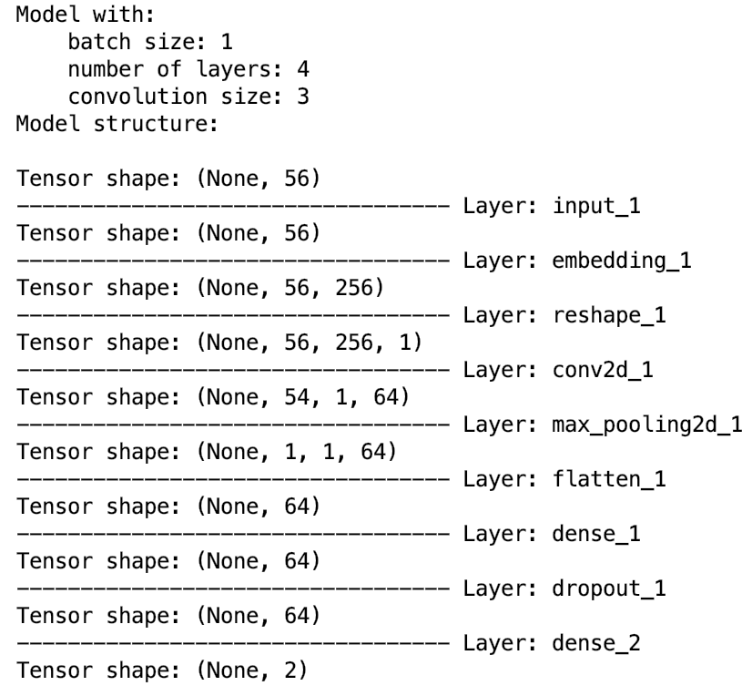
Text Classification Model
Input: 56 characters consisting in a truncated review
Model made of:
Embedding Layer
Reshape Layer
Convolutional Layer
Pooling Layer
2 Fully Connected Layers
With 6, 8, 10 total layers we’ll add every time a Convolutional and a Pooling layer.
Always present the Flatten, Dense and Dropout layers.

Slide 8
Training phase
The model has been trained for all the combinations of our degrees of freedom with these specifications:
Epochs: 10
Learning rate: 0.001
Dropout probability: 0.75
It was evaluated in the inference phase with 10 iterations.
At the end we’ll output a .csv file headed by Layers, Batch Size, Convolution Size, Total Time and Mean Time which we’ll be our so called features for the data analysis.
Total Time is the entire time that takes the inference.
Mean Time is the mean of the inference times in the 10 iterations.

Slide 9
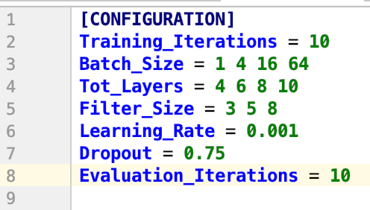
Config file
All of the degrees of freedom are configurable with this config file present in the project folder.

Slide 10
Benchmarks
Both the benchmarks, besides of writing the final .csv file, will output the model structure (as shown in the previous slides) and for each iteration:
The sizes of the degrees of freedom of that specific iteration
The total elapsed time
The prediction time
The prediction that the model made next to the actual value to be predicted
In the next slides we can see the two examples.

Slide 11
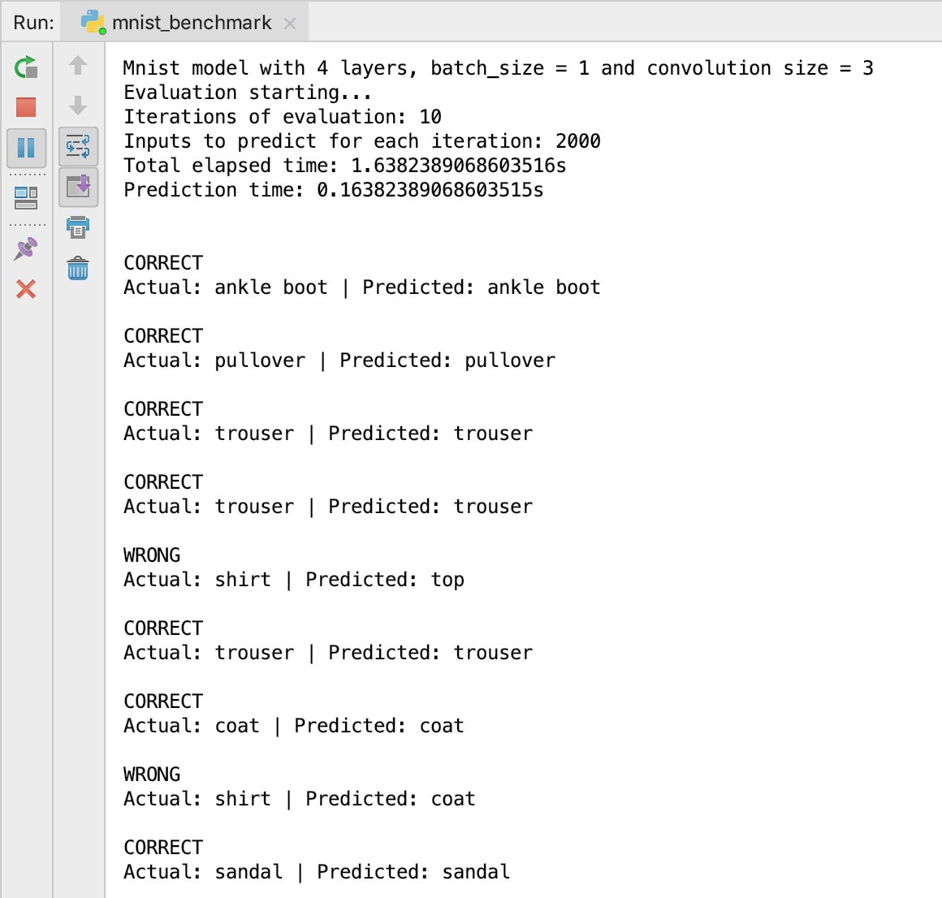
Benchmarks
Fashion MNIST benchmark output

Slide 12
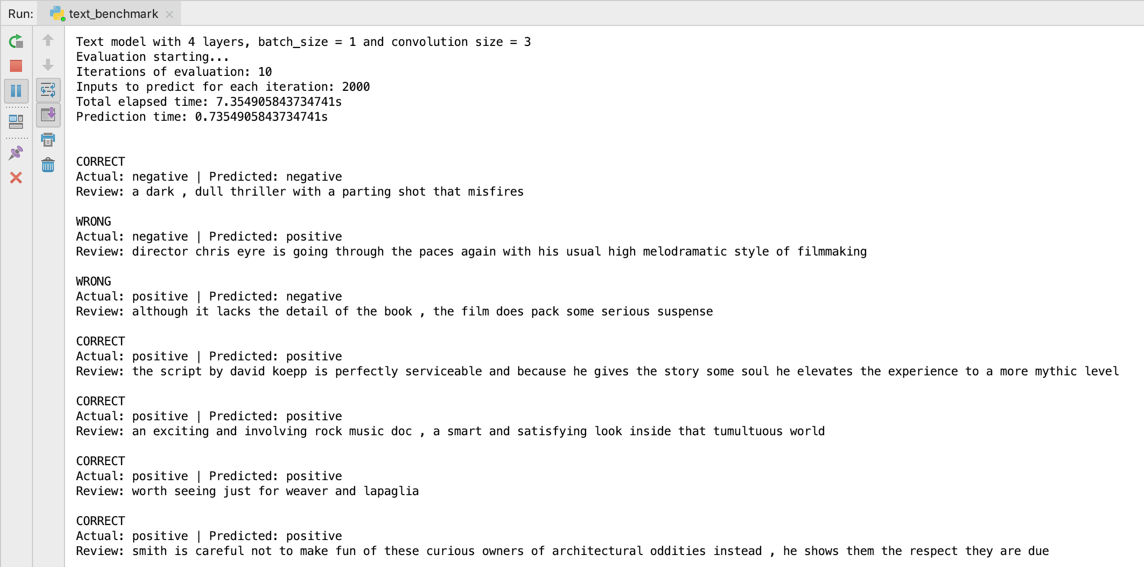
Benchmarks
Text Classifier benchmark output

Slide 13
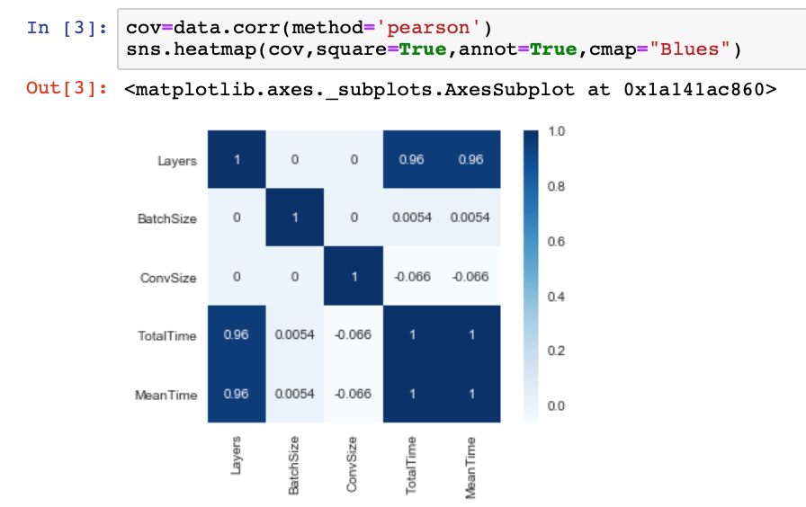
Analysis of the results – Correlation Matrix
Fashion MNIST
If we plot the correlation matrix between all our features we can spot a very high correlation between the number of layers and the time features. This means that the inference time is driven principally by the number of layers in the model.

Slide 14
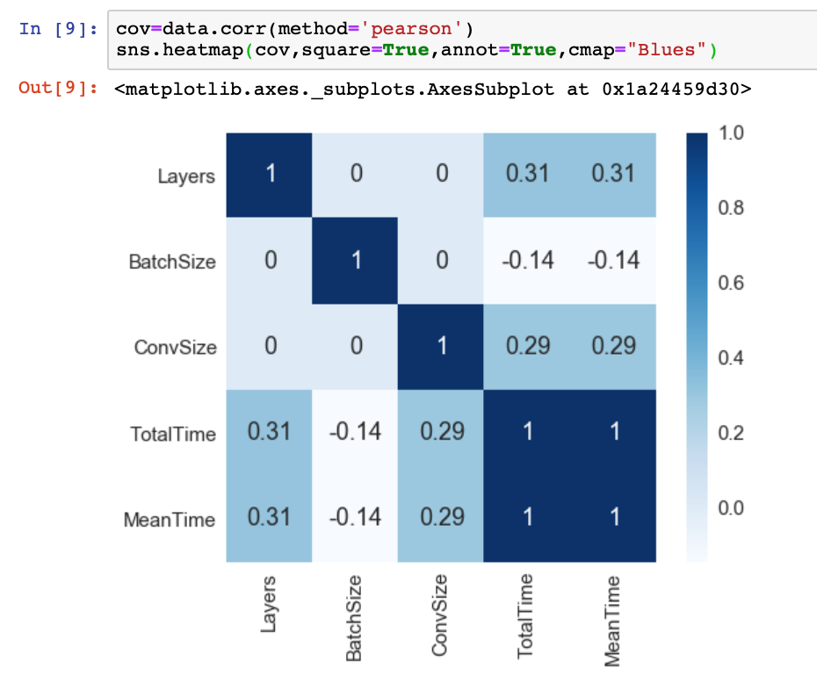
Analysis of the results – Correlation Matrix
Text Classifier
Here we cannot spot very high correlations like we did for the Fashion MNIST model. In this case the time features are equally correlated to both Number of Layers and Convolutional Size.

Slide 15
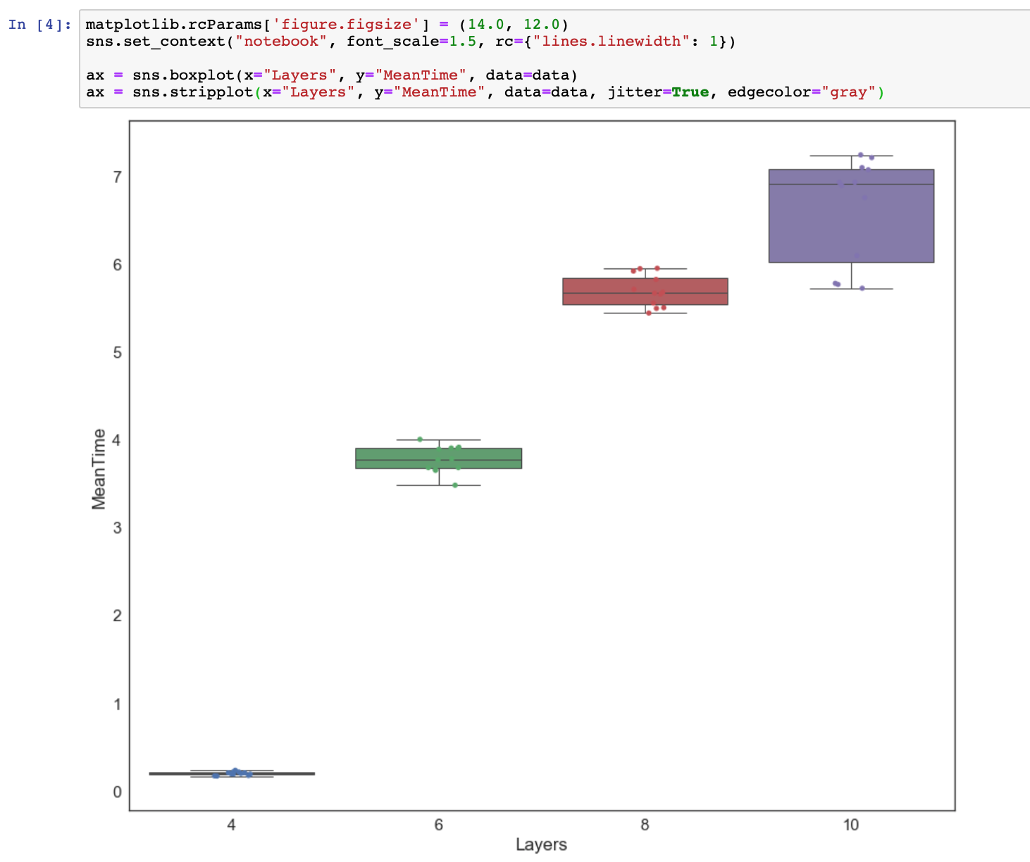
Analysis of the results - Boxplots
Fashion MNIST
Here we plotted some boxplots to
show how are distributed the
values of the Mean inference Time for each number of layers involved.
We can clearly see how the Mean inference Time increases in like a logarithmic way.
It’s interesting even the fact that, with more layers, also the variance of the values of Mean Time increases.

Slide 16
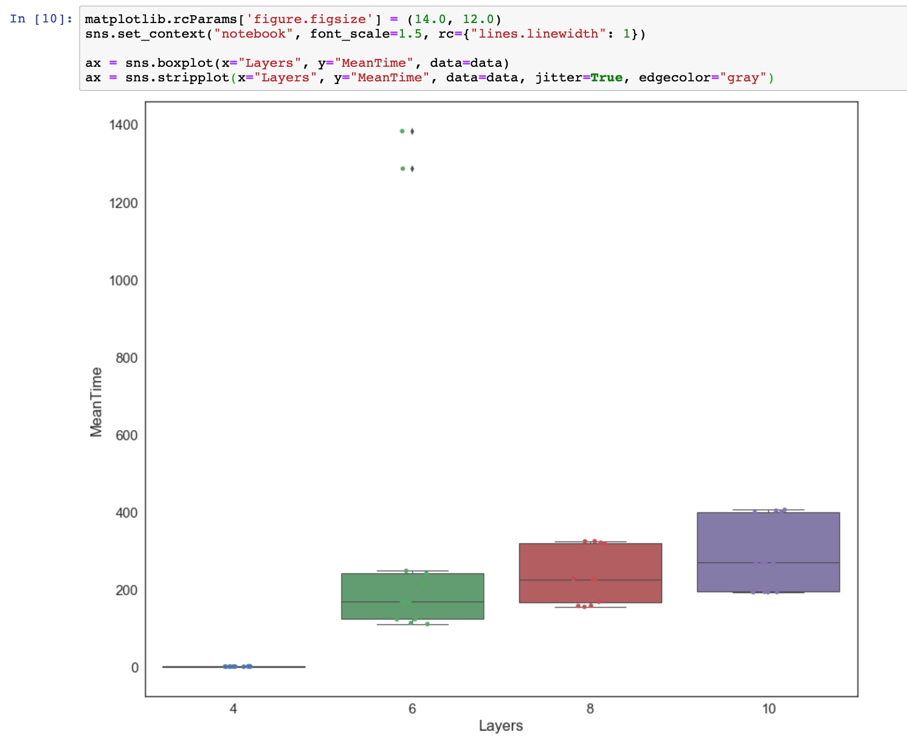
Analysis of the results - Boxplots
Text Classifier
Again we plotted some boxplots to show how are distributed the
values of the Mean inference Time for each number of layers involved.
Here the differences are not as sharp as in the other model.
Again we can see that, with more layers, also the variance of the values of Mean Time increases.

Slide 17
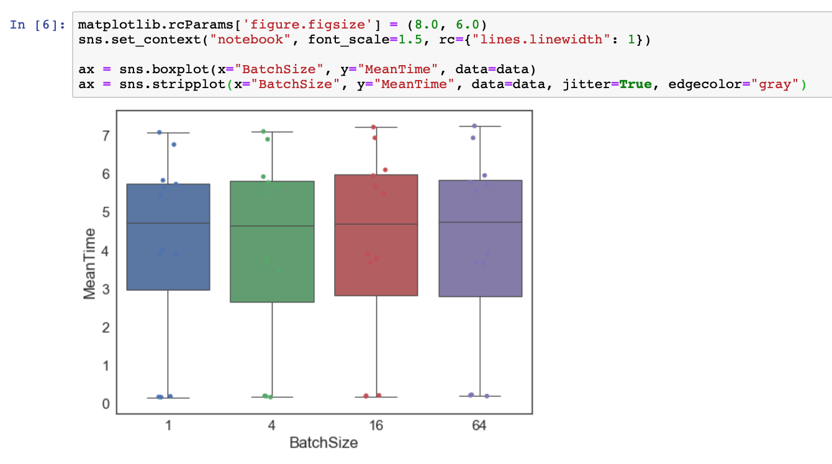
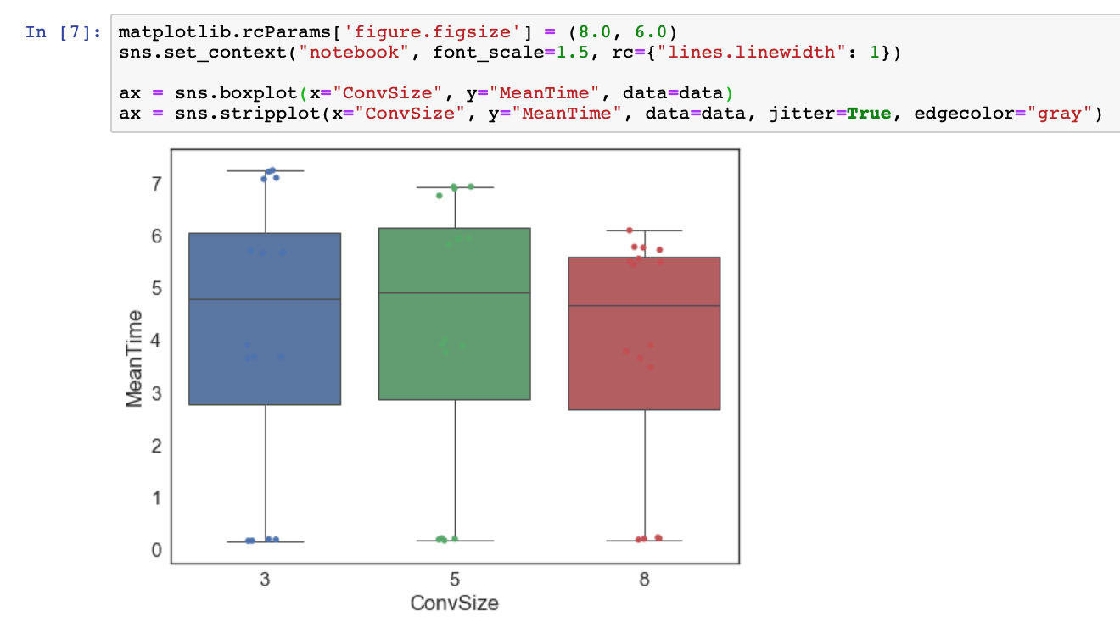
Analysis of the results - Boxplots
Fashion MNIST
When we try to plot the same boxplots to see the relation between Mean Time and both Batch Size and Convolution Size we get the results in the figures below.
We have not significant differences in the inference time neither for Batch Size nor for Convolution Size.
Moreover we thought that increasing the Convolution Size (which is the size of the filters) the Mean Time could have been less but this doesn’t happen with ConvSize = 5, and happens only a little bit with ConvSize = 8.

Slide 18
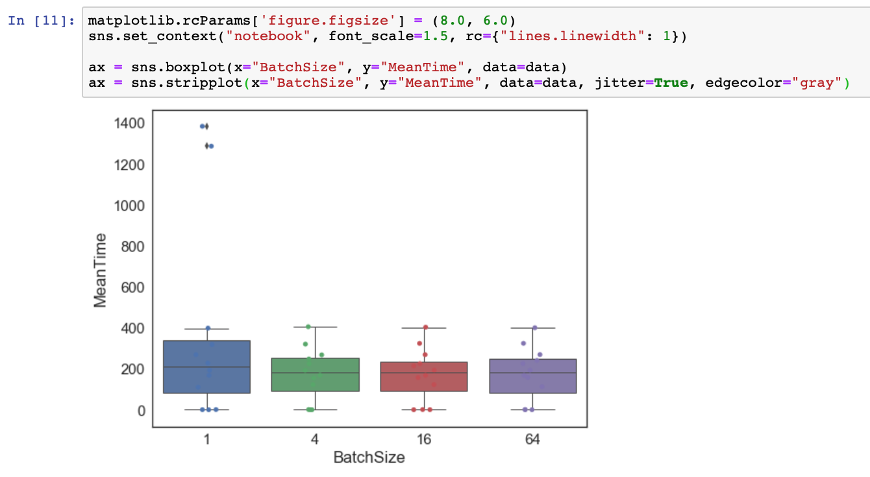
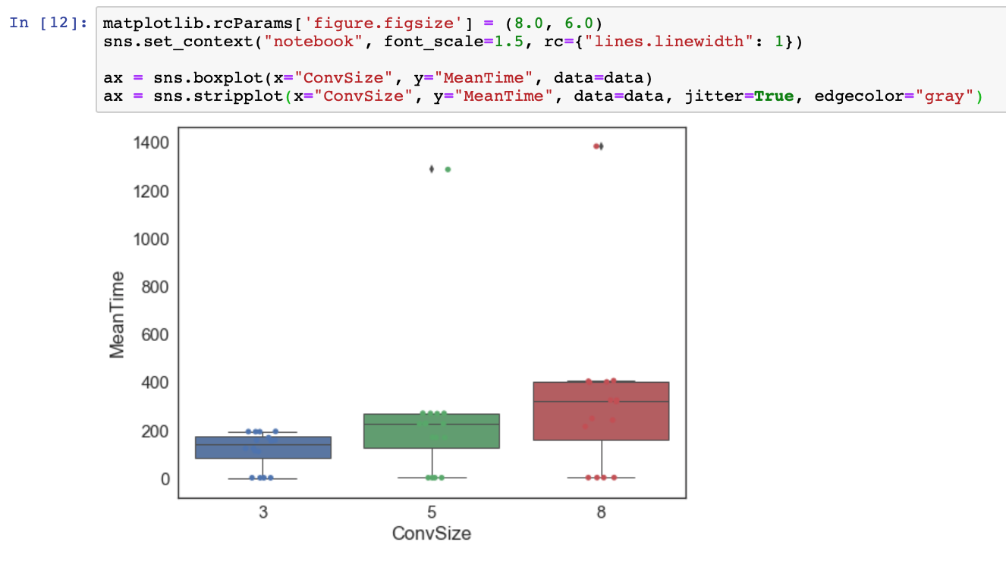
Analysis of the results - Boxplots
Text Classifier
As we could expect from the correlation matrix shown before we can see that the convolution size still have an impact on the Mean inference Time, keeping the same characteristic of increase the variance of the results proportionally to the size of the convolution.
The Batch Size confirms to be more or less unrelated to the inference time.

Slide 19
References
Starting point:
https://www.tensorflow.org/
https://www.tensorflow.org/tutorials/layers#intro_to_convolutional_neural_networks
https://www.tensorflow.org/tutorials/deep_cnn#highlights_of_the_tutorial
Code we borrowed and tutorials we used:
https://github.com/bhaveshoswal/CNN-text-classification-keras
https://www.pyimagesearch.com/2019/02/11/fashion-mnist-with-keras-and-deep-learning/
Our GitHub repository:
https://github.com/filippocollini/tensorflow_benchmark

